Slide 1
Problem
Sarah wants to fumigate her shed for ants. If one can of spray will treat 15 m³. How many cans will she need for her shed.
Notes:
Set – How will Sarah decide on the number of cans.
Measure the size of her shed.
Find the volume
How do you find the volume of this shade ( composite solid) – can we see that this is basically just a triangular prism on top if a rectangular prism?

Slide 2
Volume
Composite Solids

Slide 3
Learning Intention
Learning Intention
Success Criteria
Students will be able,
Interpret composite shapes as a combination of simpler solids
Evaluate the volume of composite solids by finding volumes of the component solids and adding them together.
You will
Minimum : Exercise 3.3 Question 1-3
Expected : Exercise 3.3 Question 1-6

Slide 4
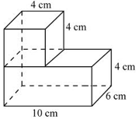
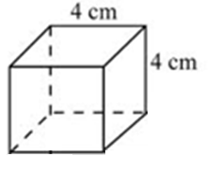
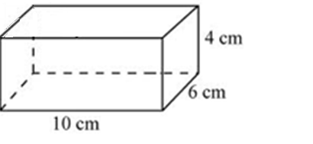


24
7
30
Volume of composite solids
Date:
EQ : How do I calculate a volume of composite solids?
Find the volume:
Process:
Break down the shape into smaller and simpler solids
Find the volume of the individual smaller solids.
Add up the volumes of the individual solids to find the total volume.
1. Break down the shape into two smaller solids
17
Notes:
INB notes
Input : Explain the process. Link it back to how they found the area of the composite shapes (Connecting to previous learning).
Modelling : Demonstrate step by step how the process can be used.

Slide 5

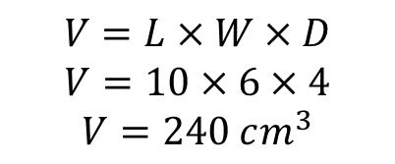
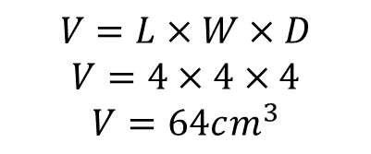
24
7
30
Volume of composite solids
Date:
EQ : How do I calculate a volume of composite solids?
2. Find the volume of the individual smaller solids.
$$V=L×W×D$$
$$V=4×4×4$$
$$V=64cm^{3}$$
$$V=L×W×D$$
$$V=10×6×4$$
$$V=240 cm^{3}$$
3. Add up the volumes of the individual solids to find the total volume
$$Volume=Volume of a cube+Volume of Rectangular Prism$$
$$=64+240=304 cm^{3}$$
17
Notes:
INB notes
Modelling : Demonstrate step by step how the process can be used.

Slide 6
Task – Guided Practice
Break down the shape into smaller and simpler solids
Find the volume of the individual smaller solids.
Add up the volumes of the individual solids to find the total volume
Find the volume of
Notes:
Guided Practice/Check for undersranding :
The problem is scaffolded here with the process shown on the PowerPoint. Guide student through this question by emplying questioning techniques.

Slide 7
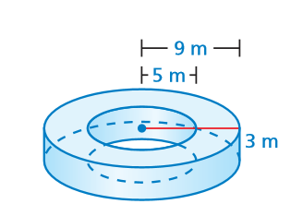
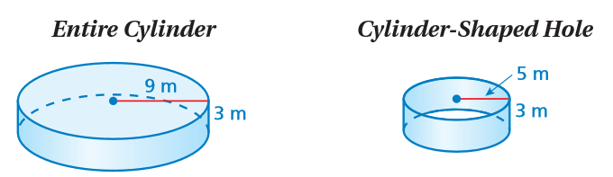


Challenge : Find Volume
Notes:
Inquiry – Ask student how you would solve a question like this?
Input – Composite shapes that can be considered as considered as a larger solid with a smaller solid cut out of it
Guided Practice – Ask student to calculate the volume of component shapes and share the final volume with class.
Volume = (243 pi – 75 pi = 168 pi = 527.5 m^3

Slide 8
Task - 2
Exercise 3.3 (Dr Dwyer textbook, Page 36)
Notes:
Guided/Independent Practice

Slide 9
Closure – Review Success Criteria
Learning Intention
Success Criteria
Students will be able,
Interpret composite shapes as a combination of simpler solids
Evaluate the volume of composite solids by finding volumes of the component solids and adding them together.
You will
Minimum : Exercise 3.3 Question 1-3
Expected : Exercise 3.3 Question 1-6
Notes:
Review the success criteria and learning intention. Ask students have they met the success criteria.
Teacher summarises the learning for the lesson.

